Slide 1
TIME SERIES ANALYSIS
Doug Friedman

Slide 2
TODAY’S LEARNING OBJECTIVES
TIME SERIES ANALYSIS
Understand what makes time series data unique compared to other analyses
Prepare and format data for time series analysis
Perform exploratory time series analysis with pandas including moving averages and autocorrelation

Slide 3
COURSE
PRE-WORK

Slide 4
PRE-WORK REVIEW
Knowledge of data analysis and formatting with pandas
Understand the correlation measure of association with python

Slide 5
OPENING
TIME SERIES ANALYSIS

Slide 6
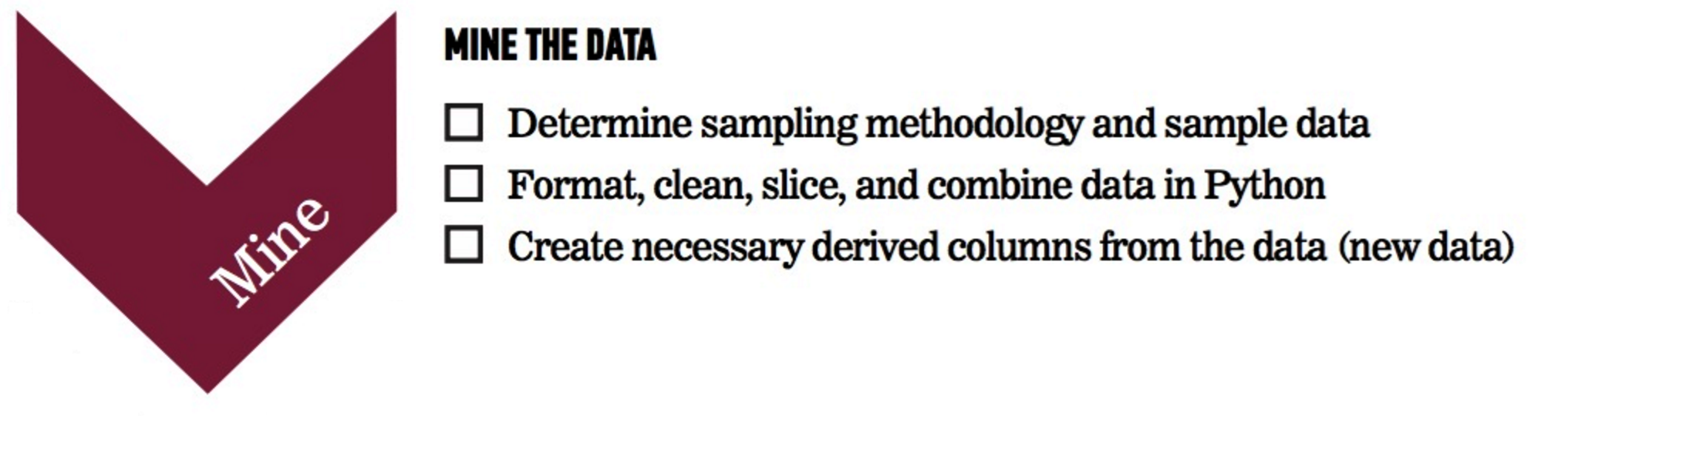
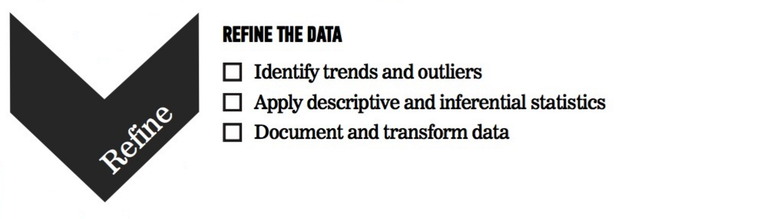
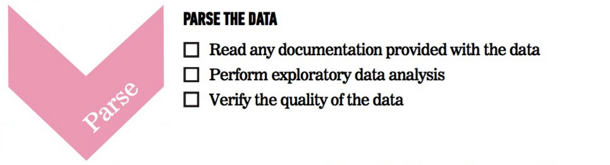
WHERE ARE WE IN THE DATA SCIENCE WORKFLOW?
Data has been acquired, but we’ll need to parse, mine, and refine it.
We’ll also use plots to represent the results.

Slide 7
TIME SERIES ANALYSIS
Today, we’ll discuss analyzing data that is changing over time. In most of our previous examples, we didn’t care about when the data points were collected.
Instead, we made assumptions that the data was not changing over time or that our analysis would not take that into account.
This class will focus on statistics around data that is changing over time and how to measure that change.

Slide 8
INTRODUCTION
WHAT IS TIME SERIES DATA?

Slide 9
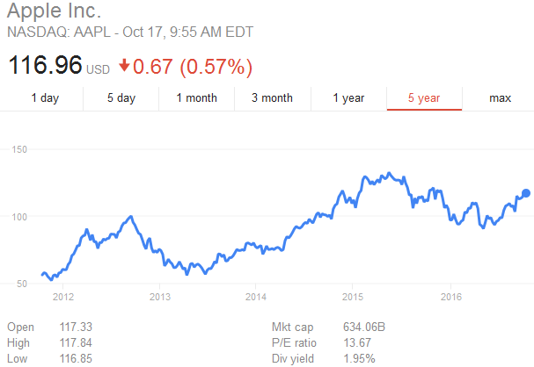
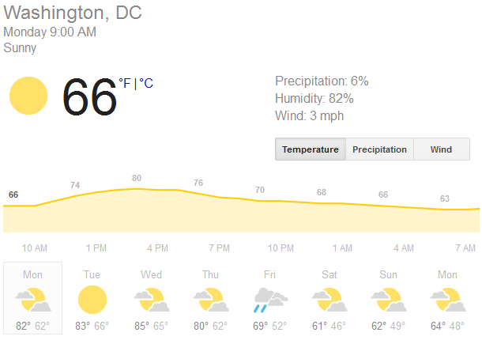
WHAT IS TIME SERIES DATA?
Time series data is any data where the individual data points change over time.
This is fairly common in sales and the physical sciences where data would likely change according to seasons and trends.

Slide 10
WHAT IS TIME SERIES DATA?
Most datasets are likely to have a time component, but typically we assume that it’s fairly minimal.
For example, if we were analyzing salaries in an industry, it’s clear that salaries shift over time and vary with the economic period.
However, if we are examining the problem on a smaller scale (e.g. 3-5 years), the effect of time on salaries is much smaller than other factors, like industry or position.

Slide 11
WHAT IS TIME SERIES DATA?
When the time component is important, we need to focus on identifying the aspects of the data that are influenced by time and those that aren’t.
Typically, time series data will be a sequence of values. We will be interested in studying the changes to this series and how related individual values are.
For example, how much does this week’s sales affect next week’s? How much does today’s stock price affect tomorrow’s?

Slide 12
GUIDED PRACTICE
THINKING ABOUT
TIME SERIES

Slide 13

ACTIVITY: THINKING ABOUT TIME SERIES
ANSWER THE FOLLOWING QUESTIONS (10 minutes):
EXERCISE
What data have you worked with or seen that would be considered time series data?
What was the most frustrating part of working with this time series data?
DELIVERABLE
Answers to the above questions

Slide 14
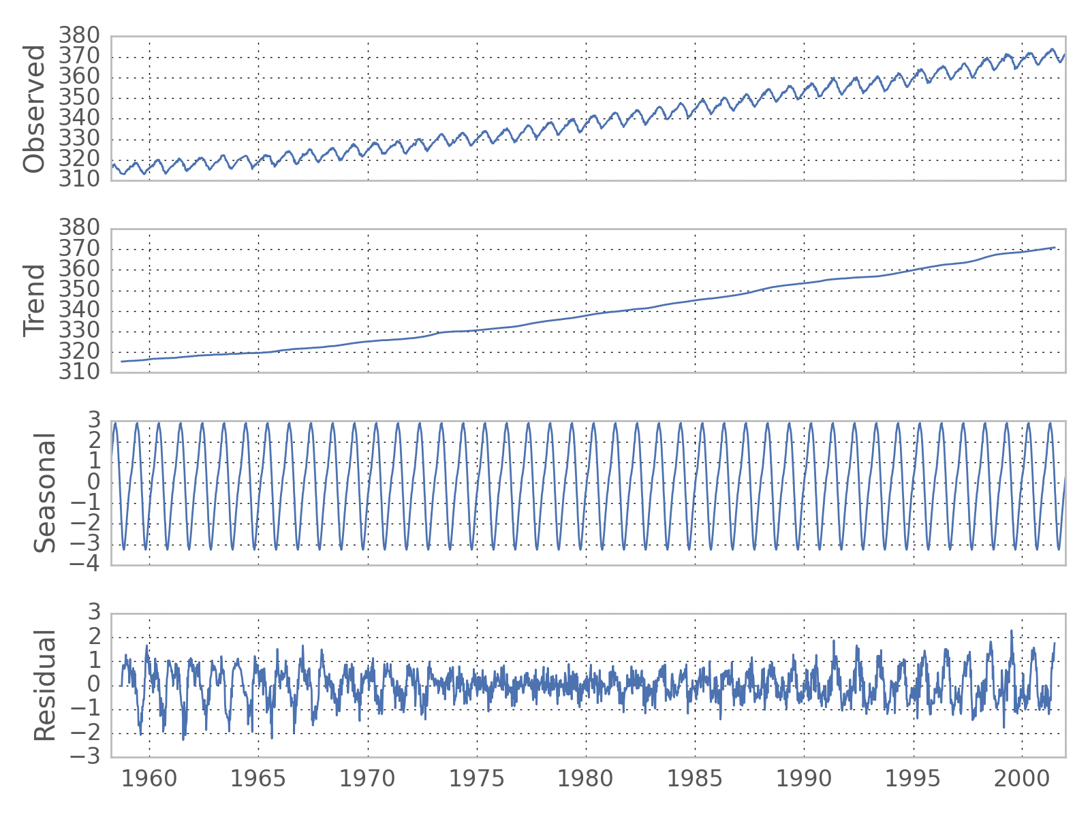
WHAT IS TIME SERIES DATA?
Much of time series analysis focuses on separating the effects of time on our data into two main components.
Trend – significant, sustained increases or decreases in our data
Seasonality – regular, repeated patterns in our data

Slide 15
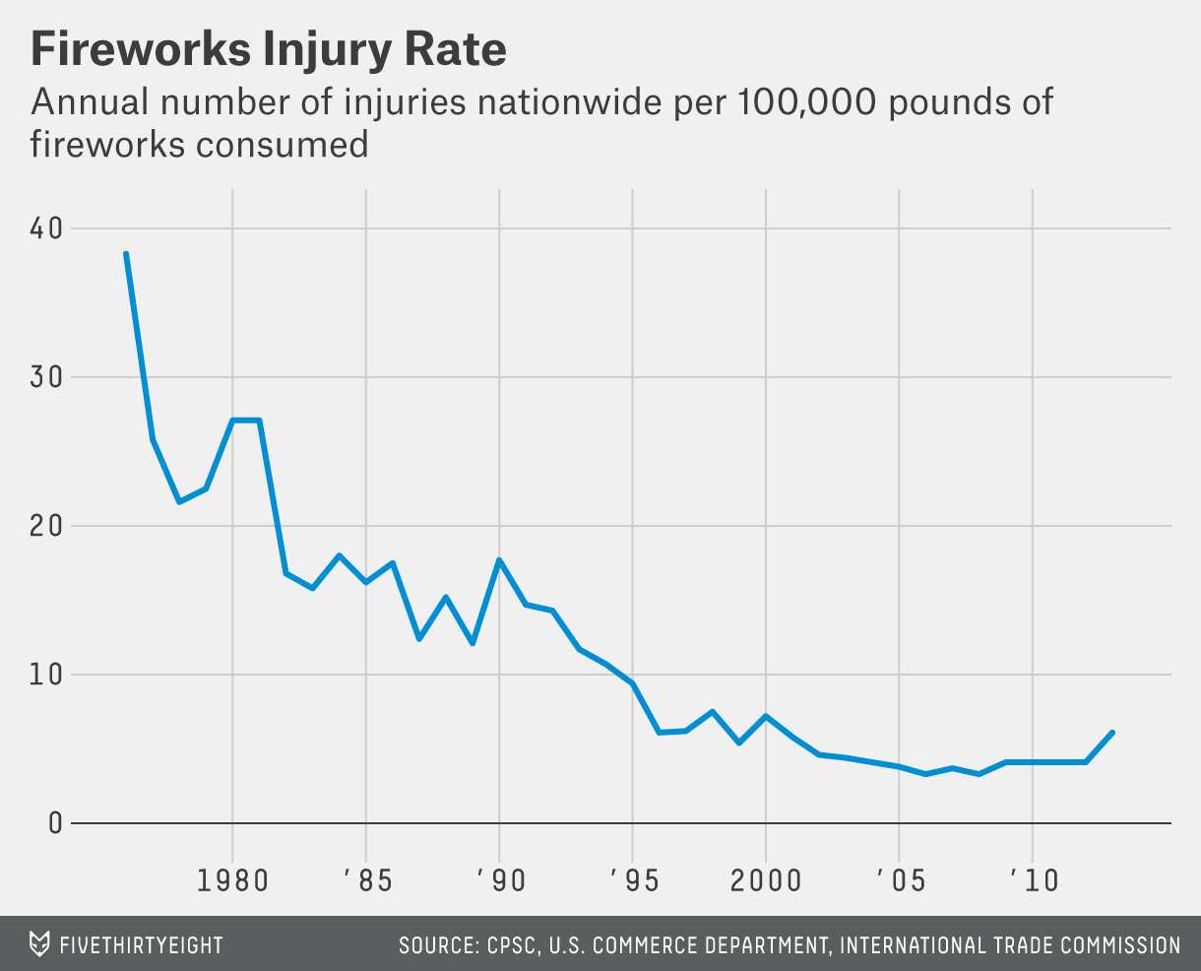
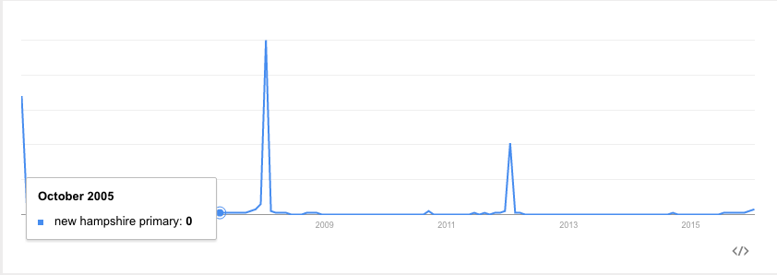
WHAT IS TIME SERIES DATA?
However, not all time series data contain significant trend and seasonality components.

Slide 16
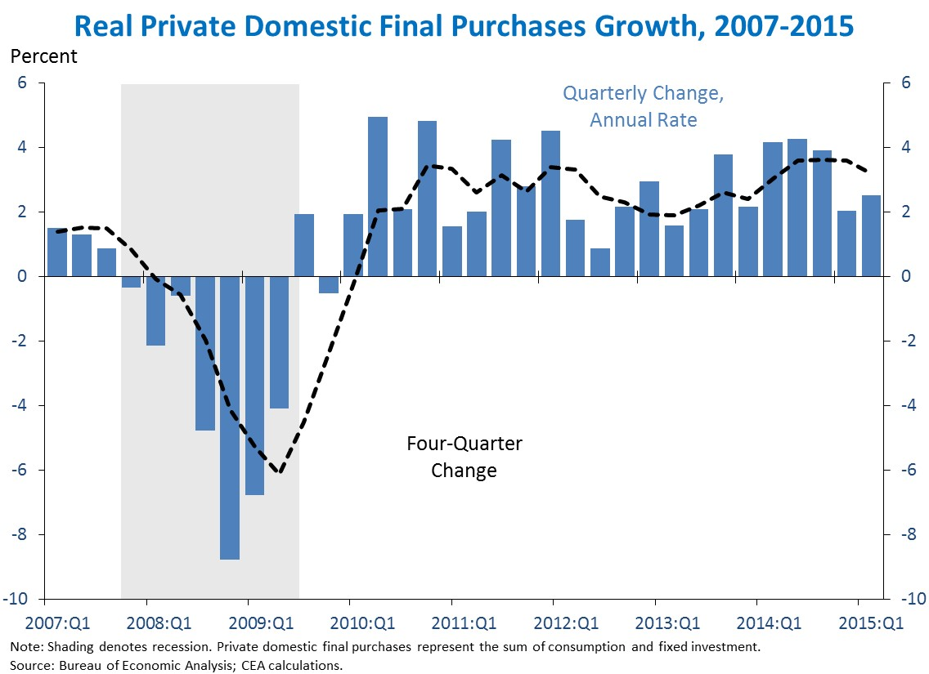
WHAT IS TIME SERIES DATA?
Many other types of regularly occurring up or down swings may occur without a fixed timescale or period (e.g. growth vs. recession for economic trends).

Slide 17
WHAT IS TIME SERIES DATA?
These aperiodic patterns are called cycles.
While identifying aperiodic cycles is important, they are often treated differently than seasonal effects. Seasonal effects are useful for their consistency, since prior data is useful as a predictor.

Slide 18
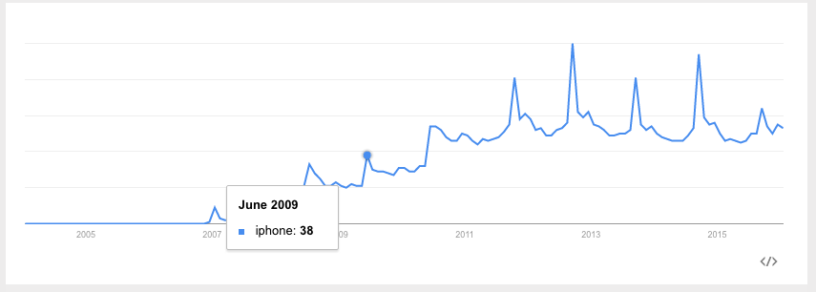
WHAT IS TIME SERIES DATA?
Searches for “iphone” have both a general trend upwards (indicating increasing popularity overall) as well as a seasonal spike in September (when Apple typically announces new versions).

Slide 19
INTRODUCTION
PARSING AND MINING
TIME SERIES DATA

Slide 20
PARSING AND MINING TIME SERIES DATA
As with other analyses, parsing and mining our time series data is going to be key to performing our analysis.
However, this can be tricky working with time series data. Often, the time information is formatted strangely or there are missing values in our regular observations.
As a result, we’re going to want to make sure that our data has been imported properly and the time information is being correctly interpreted by Python.

Slide 21
DEMO
PARSING AND MINING
TIME SERIES DATA

Slide 22
PARSING AND MINING TIME SERIES DATA
Open up starter-code-15 and let’s walkthrough how to use Pandas to parse and mine a sample time series dataset.

Slide 23
GUIDED PRACTICE
PARSING AND MINING
TIME SERIES DATA

Slide 24
ACTIVITY: PARSING AND MINING TIME SERIES DATA
ANSWER THE FOLLOWING QUESTIONS (10 minutes):
EXERCISE
Using our original dataset (slr), create a new dataframe called dc_slr that contains only information about the date and the sea level in DC.
Use our three parsing and mining steps (Formatting, Indexing, and Interpolating) to prepare it for analysis.
DELIVERABLE
Answers to the above questions

Slide 25
INTRODUCTION
REFINING
TIME SERIES DATA

Slide 26
REFINING TIME SERIES DATA
Now that we’ve parsed and mined our data, we can use it for analysis!
The most common approach to analyzing time series data is to calculate a moving/rolling average of our data or the average of a changing subset or window our of data.
The average of this list [1, 2, 3, 4, 5] is 3, but the moving average with a window of 3 would be [NaN, NaN, 2, 3, 4].
Note that NaNs are generated for the entries where there is not enough data to calculate the moving average.

Slide 27
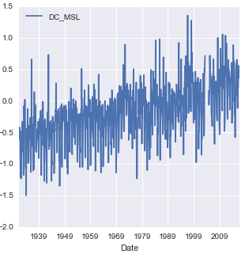
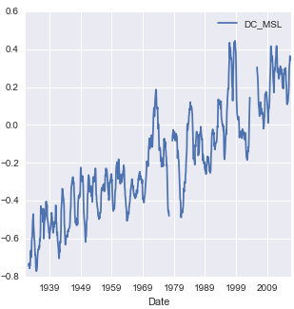
REFINING TIME SERIES DATA
The reason why moving averages are so popular is because they smooth out the noise in our data to give a clearer picture of the overall trend.
Moving Average
(with Window 12)

Slide 28
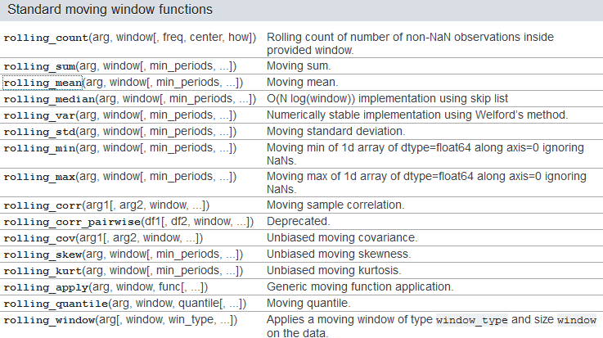
MOVING AVERAGES
Pandas includes a series of moving/rolling functions that you can use to easily calculate different summary statistics over a window of time series data.

Slide 29
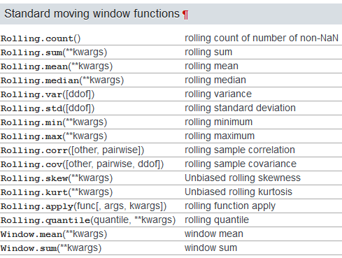
MOVING AVERAGES
If you have Pandas >= 0.18.0 installed, the syntax for these function (and some of the later ones) is similar but slightly different.

Slide 30
MOVING AVERAGES
While moving averages weight all data within our window evenly, it may make sense to weight data closer to our date of interest higher. This would indicate that the present is worth more to our calculation than the past.
We do this by taking a weighted moving average, where we assign particular weights to certain time points.
Various formulas or schemes can be used to weight the data points, the most common weighting is an exponential weighted moving average (EWMA) where we give increasingly less weight to older data points.

Slide 31
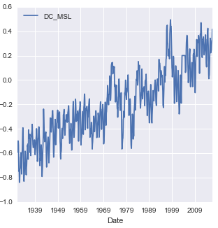
MOVING AVERAGES
Here’s what an EWMA looks like with our DC sea level data.
EWMA
(with Span 12)

Slide 32
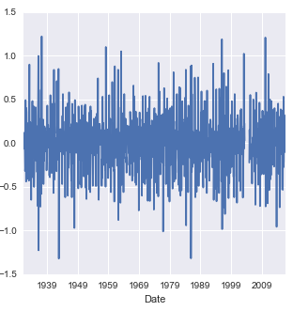
MOVING DIFFERENCES
Often, it can also be useful to calculate the moving/rolling differences to identify the change between past and current observations.
Moving Difference
(with Periods 1)

Slide 33
AUTOCORRELATION
In previous classes, we have been concerned with how two variables are correlated (e.g. height and weight, education and salary) as a measure of association between them.
In time series analysis, it can be important to determine if a variable is correlated with itself (e.g. if there is an association between past and present data points). This measure is known as autocorrelation.
A strong autocorrelation indicates a relationship between past and present data points while a weak autocorrelation represents a lack of association between past and present data points.

Slide 34
AUTOCORRELATION
To compute autocorrelation, we also specify the lag or how many time points earlier we should use to compute the correlation.
A lag of 1 computes how correlated a value is with the prior one. A lag of 10 computes how correlated a value is with one 10 time points earlier.
Here’s a few sample autocorrelations with our DC sea level rise data:
Lag | Autocorrelation
1 | 0.699
3 | 0.369
6 | 0.187
12 | 0.635

Slide 35
AGGREGATION
It may also be useful to aggregate our data along specific timeframes such as turning monthly data into annual data as this removes any intra-annual seasonality.
In order to do this, we’ll need to specify a summary statistic to aggregate with though (e.g. average).
We can do this using pandas’ resample function which turns our monthly sea level data into annual average sea level data.

Slide 36
DEMO
REFINING
TIME SERIES DATA

Slide 37
REFINING TIME SERIES DATA
Open up starter-code-15 and let’s take a look at some of these refinement functions in action.

Slide 38
INDEPENDENT PRACTICE
REFINING
TIME SERIES DATA

Slide 39
ACTIVITY: REFINING TIME SERIES DATA
ANSWER THE FOLLOWING QUESTIONS (30 minutes):
EXERCISE
Using the Chesapeake Bay sea level data, answer the following questions and interpret the result.
Calculate the moving/rolling standard deviation with rolling_std for a window of 12 with center=True and center = False.
Calculate the autocorrelation with lag 1 and lag 24.
Calculate the annual maximum sea level and plot the results.
DELIVERABLE
Answers to the above questions

Slide 40
CONCLUSION
TOPIC REVIEW

Slide 41
CONCLUSION
We use time series analysis to identify changes in values over time. Normally, we want to identify whether changes are true trends or seasonal changes.
Before any analysis, we must format, index, and interpolate our time series data.
Moving averages give us a local summary statistic in time, smoothing out random fluctuations and removing outliers.
Autocorrelations are a measure of how much a data point is dependent on previous data points.

Slide 42
COURSE
BEFORE NEXT CLASS

Slide 43
DUE DATE
BEFORE NEXT CLASS
Project: Final Project, Part 4

Slide 44
LESSON
Q & A

Slide 45
LESSON
EXIT TICKET
DON’T FORGET TO FILL OUT YOUR EXIT TICKET
LESSON 15
TIME SERIES ANALYSIS

Slide 46
CITATIONS
THANKS FOR THE FOLLOWING
Rolling Functions: http://pandas.pydata.org/pandas-docs/version/0.17.0/api.html#standard-moving-window-functions
Newer Rolling Functions: http://pandas.pydata.org/pandas-docs/version/0.18.1/api.html#standard-moving-window-functions

